Slide 1


WebAssembly (WASM) - Going to beyond containers
Ben Li, SAP I&CX Commerce Cloud Development(China)
July, 2022

Slide 2
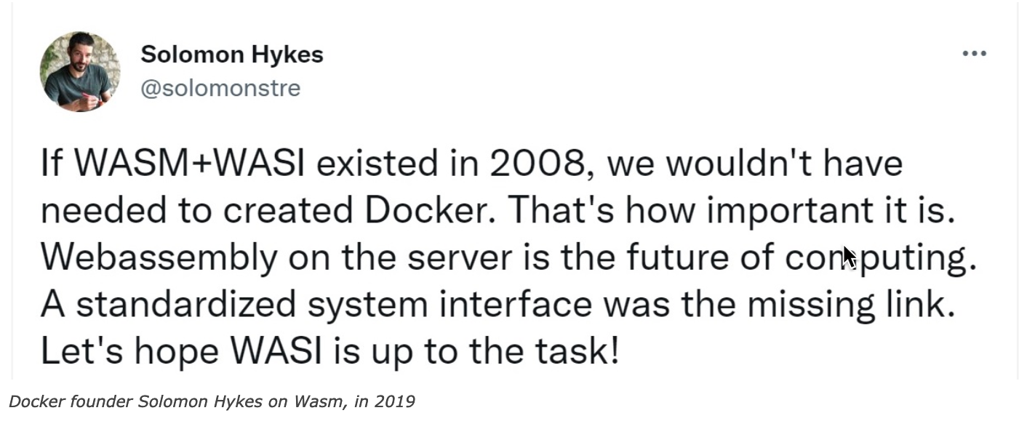
WebAssembly - History
Originally designed for performance purpose of web browser applications only.
Announced by W3C at 2015.
WebAssembly MVP specification was published at 2017.
More and more language runtimes start to support WebAssembly (2017 ~ Now)
WebAssembly 2.0 specification was draft at 2022.
KubeCon & CloudNativeCon Europe 2023
– WASM+K8S Beyond Containers: https://www.youtube.com/watch?v=1_iCimJrLzM

Slide 3
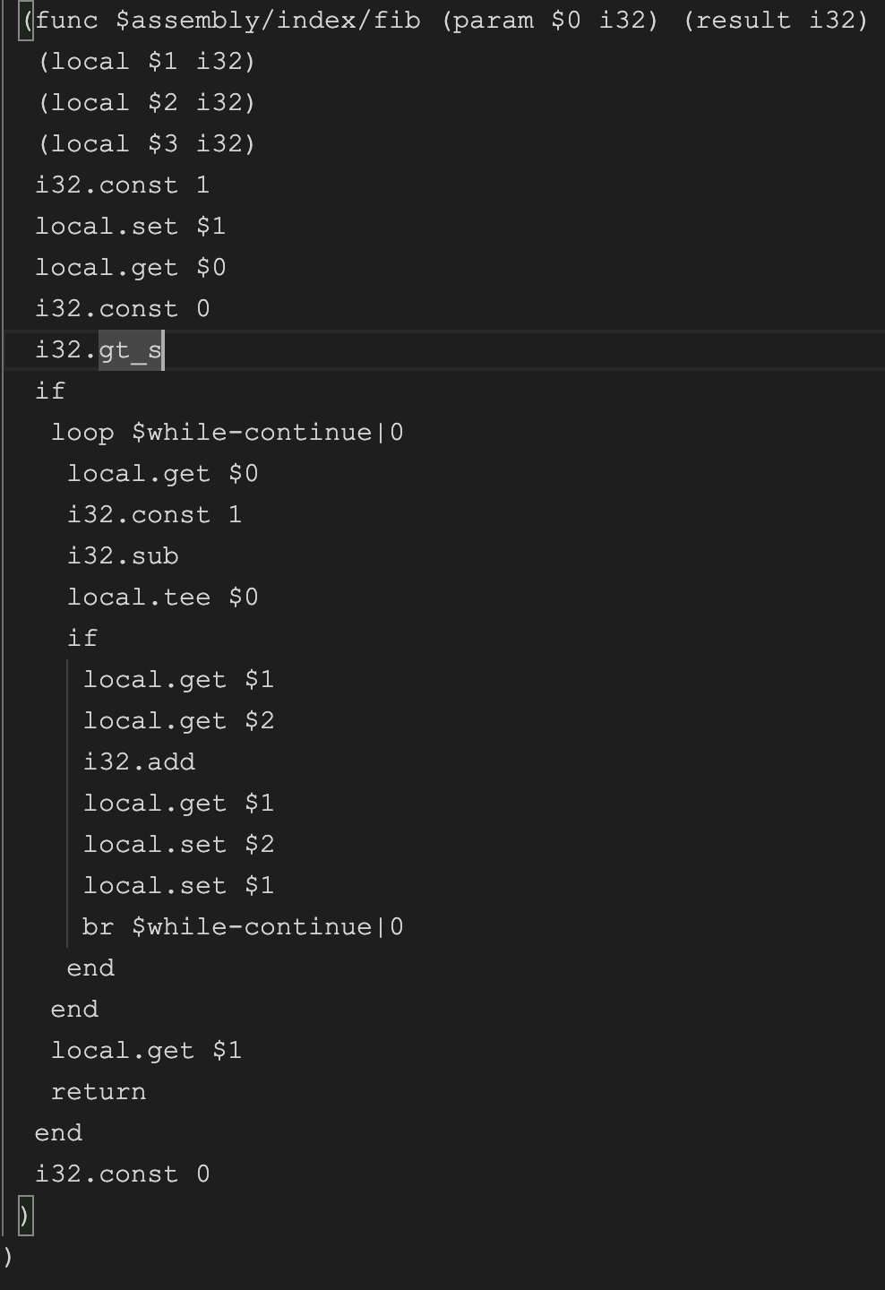
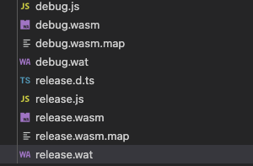
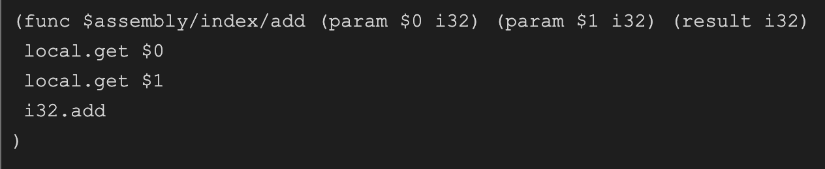
What is WebAssembly
WebAssembly is a language, but you don’t write it.
WebAssembly code has both text readable and binary format.
Text format: *.wat
Binary format: *.wasm

Slide 4
What is WebAssembly
WebAssembly is a language, but you don’t write it.
WebAssembly code has both text readable and binary format.
Text format: *.wat
Binary format: *.wasm
Get the number in fibonachi sequence at index n.
Add two integers and return the sum

Slide 5
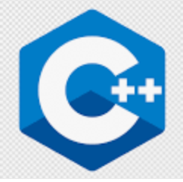





What is WebAssembly
WebAssembly defines the code specification, with which other languages/runtimes provide compiler to compile code to WebAssembly.
emscripten
wasm-bindgen
compile
AssemblyScript Tool Chain
Shopify/Javy
TeamVM

Slide 6
What
WebAssembly is a runtime, in which WebAssembly code runs.
WebAssembly runtime can be hosted by many different types runtimes. (Host runtime & Wasm runtime)
Browser
(V8, Mozila…)
Rust, C++, Nodejs, Java, C#…
Docker WASM, K8S Kruslet, Azure Blazor
Wasmtime, Wasmer, WasmEdge…
SAP Oyster
WASM Runtime
WASM Runtime
WASM Runtime
WASM Runtime
WASM Runtime
SAP Oyster Framework: https://pages.github.tools.sap/oyster/doc/?rc=1

Slide 7
What is WebAssembly
Simply speaking, you can write code in any language and compile it to be a WASM format which can be executed in any runtime.
Host Runtime
WASM Code
Your code
Compiler
You write in C++, Rust, Javascript, C#…
Running in C++, Rust, Javascript, Nodejs, C#…

Slide 8
What is WebAssembly – Key Concept
Instance: Works as a WebAssembly runtime instance living in host environment.
Module: A compiled WebAssembly code file will be loaded as a module.
Export: WebAssembly code in a module can be exported as functions, which host runtime code can invoke it.
Import: Host runtime functions can be imported into WebAssembly running instance, with which interoperation can be implemented between host runtime and WebAssembly runtime.
Liner Memory: Host runtime provide a piece of size limited liner memory, WebAssembly code working with this memory.
WebAssembly Concept - Mozilla: https://developer.mozilla.org/en-US/docs/WebAssembly/Concepts

Slide 9
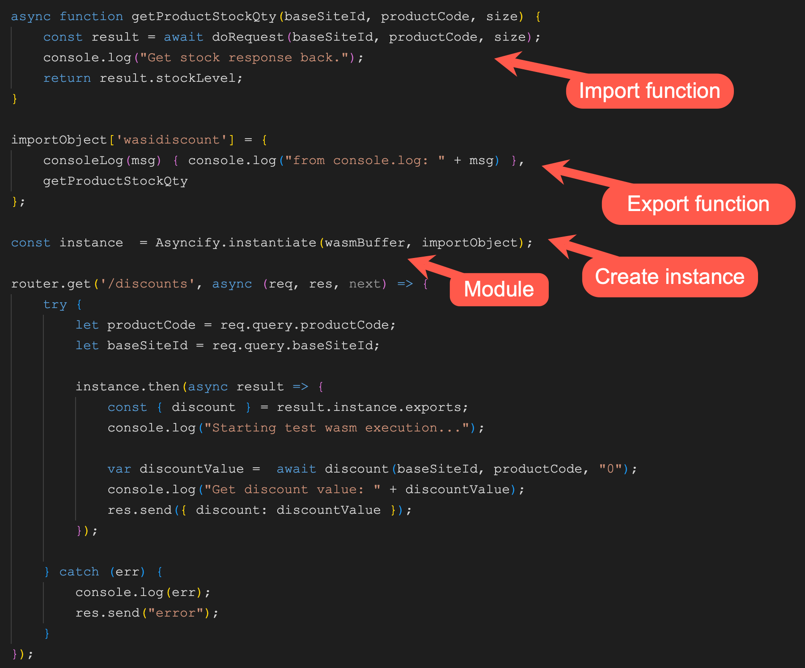
What is WebAssembly – Key Concept
Host Runtime
WebAssembly Instance
…
bar();
…
Module
export
function bar(){
…
}
WASM code artifact
function foo(){
…
}
import
…
foo();
…
Module

Slide 10
WASI – WebAssembly System Interface
WASI is a specification which is trying to define a set of interfaces with which WebAssemlby runtime is able to access system level Objects APIs, resources of host runtime.
Console log, System datetime…
Input Stream / Output Stream
Networking
Other system level resources.
It is in developing… https://github.com/WebAssembly/WASI
Host Runtime
WASM Runtime
WASM
WASM
WASI
WASI
Console, File, Networking, System…

Slide 11
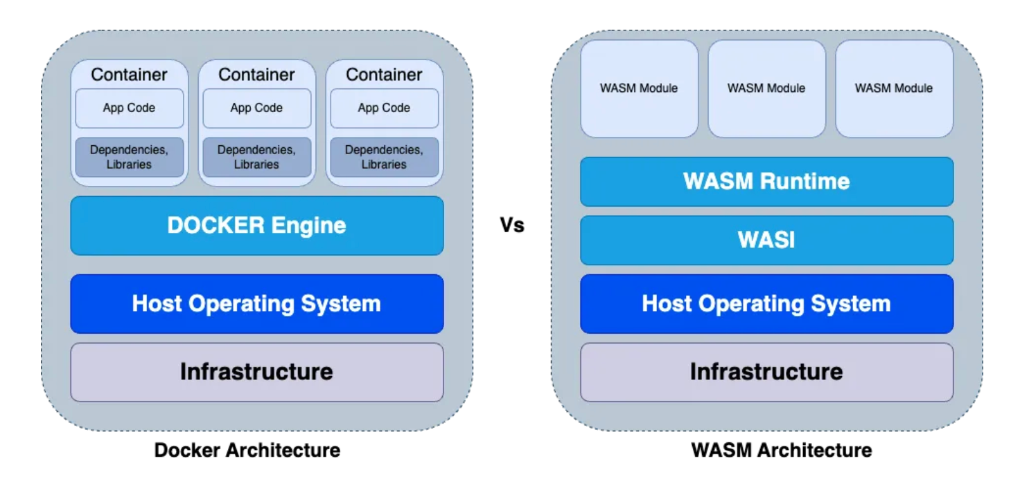
WebAssembly vs Containers
Containers is an abstraction of OS
WebAssembly is an abstraction of code runtime
From medium.com
https://medium.com/@shivraj.jadhav82/webassembly-wasm-docker-vs-wasm-275e317324a1

Slide 12
Why WebAssembly
Performance:
Binary code execution speed.
Small resource consumption:
KB/Bytes level of WASM code module usually.
MS level time consumption of instantiating WASM runtime.
Security:
Designed as a sandbox
Limited memory consumption in WASM runtime (Liner Memory)
Polyglot:
Many language options to guest language
Many language options be host language

Slide 13
WebAssembly Scenarios
Web/Desktop applications performance
Computation intensive tasks
Encryption, Hash, Algorithm…
Graphic, Video…
Sandboxing
Plugins, AddOns to Web/Desktop applications
Extensibility to enterprise applications
Edge Computing
WasmEdge: https://wasmedge.org/
Serverless

Slide 14
WebAssembly Scenarios
Reference Case:
Google Earth: https://medium.com/google-earth/google-earth-comes-to-more-browsers-thanks-to-webassembly-1877d95810d6
Figma: https://www.figma.com/blog/webassembly-cut-figmas-load-time-by-3x/
Shopify: https://shopify.engineering/shopify-webassembly
MOSN: https://mosn.io/blog/posts/mosn-wasm-framework/ (Chinese)
Aiqiyi: https://www.infoq.cn/article/kvafmaidop0ivdrafwtc (Chinese)

Slide 15
WebAssembly – Application Extensibility
An overview concept of cloud application extensibility (Security, Performance, Resource Consumption…):
Cloud Application Cluster (K8S)
Application Container
Ext. Service
In process WASM instance
…
…
Ext. point
…
…
WASM Repo
WASM Compiler
Extensibility IDE
Extension Developer
Seperated container WASM instance

Slide 16
WebAssembly – Application Extensibility
Commerce Cloud In-App Extensibility PoC – customized discount calculation:
Commerce Application (JVM)
Extensibility (Nodejs)
placeOrder() {
int discount = extDiscount();
…
}
Discount API
discount() {
…
var stock = getStock();
….
return discount;
}
Stock API
Stock API proxy
Asyncify: https://emscripten.org/docs/porting/asyncify.html
https://kripken.github.io/blog/wasm/2019/07/16/asyncify.html

Slide 17
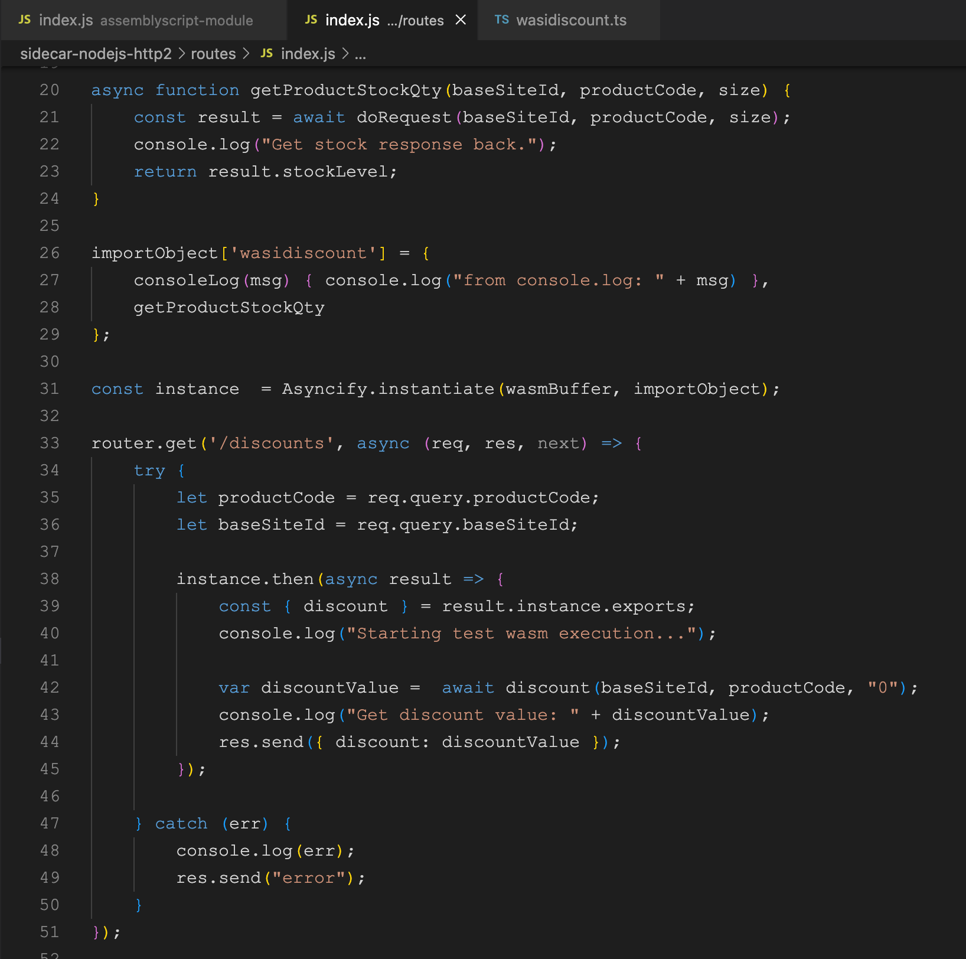
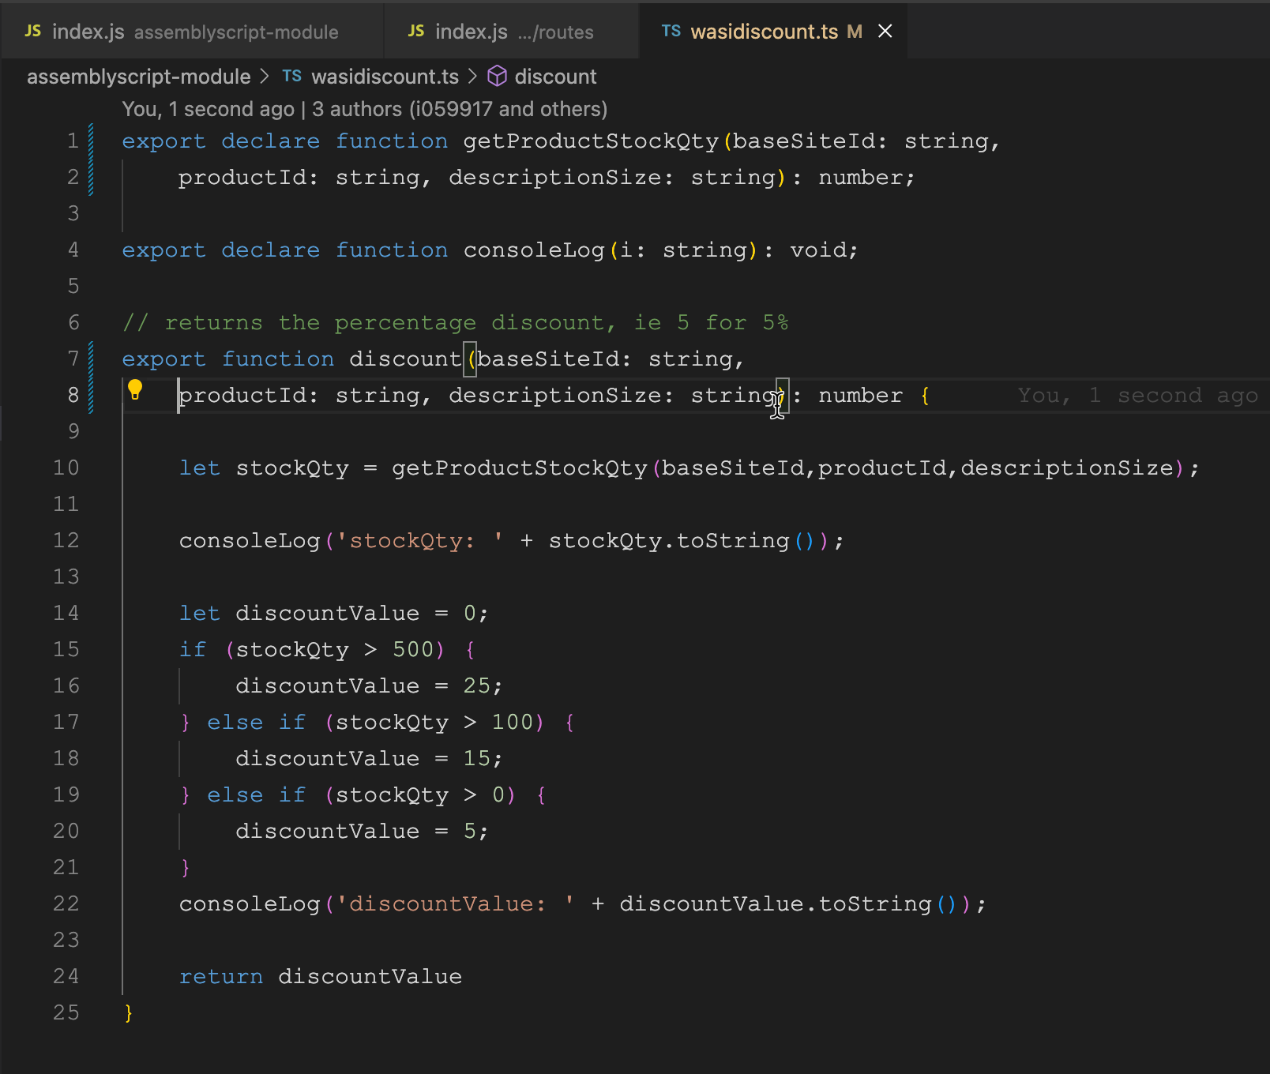
WebAssembly – Application Extensibility
Commerce Cloud In-App Extensibility PoC:
2
3
1
4

Slide 18
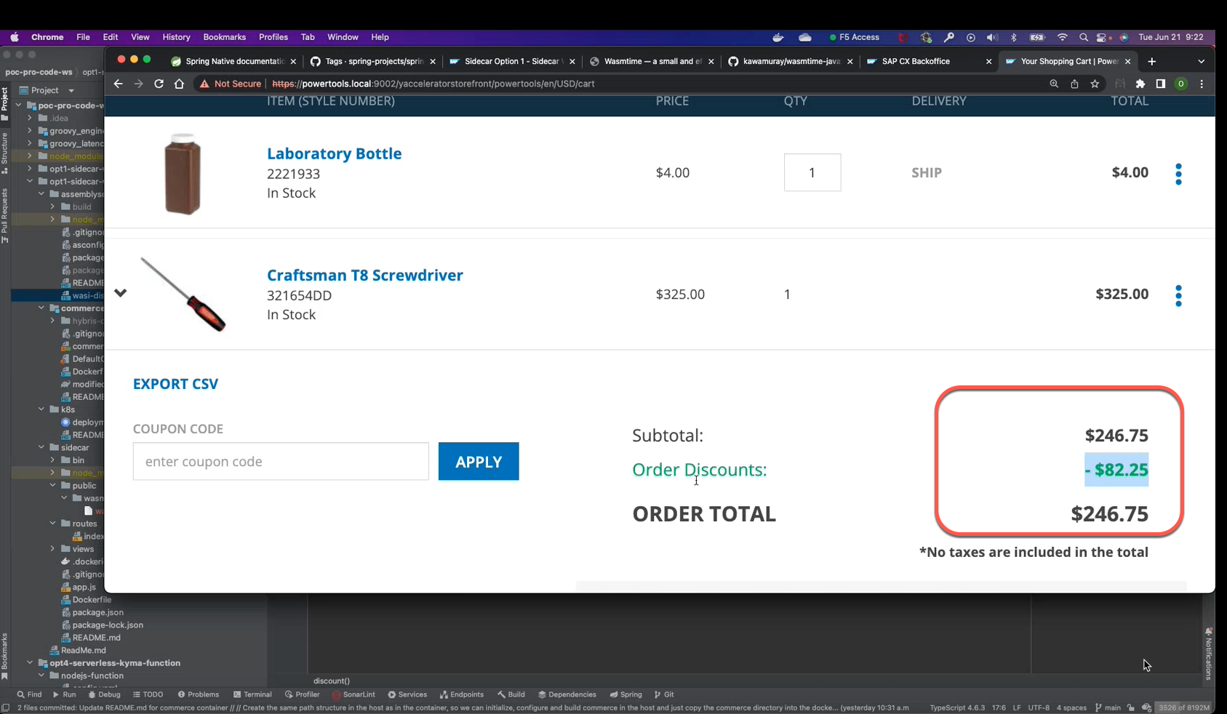
WebAssembly – Application Extensibility
Commerce Cloud In-App Extensibility PoC:

Slide 19
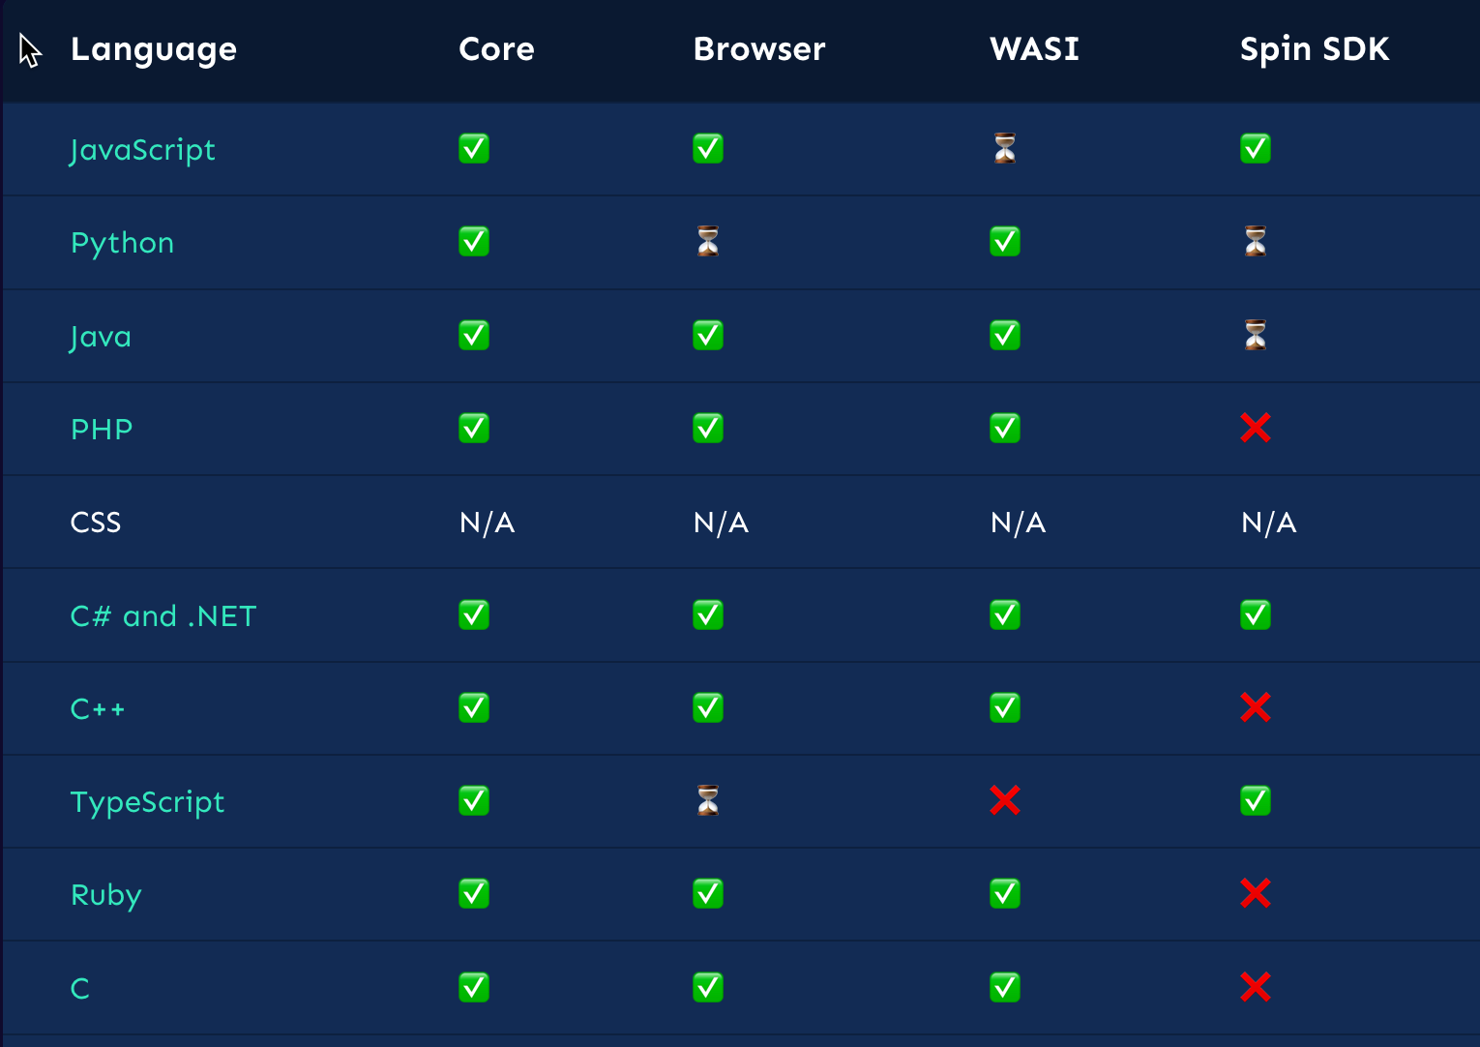
WebAssembly – Language Support & Selection
Host language:
Rust, Javascript, Nodejs, C#
C++, Python, GO, Java(GraalVM)…
Guest language
Rust, C++, AssemblyScript(Typescript)
C#, Javascript, Python, GO
Java…
https://www.fermyon.com/wasm-languages/cpp
https://github.com/appcypher/awesome-wasm-langs
From www.fermyon.com

Slide 20
WebAssembly – Now & Future
Powerful in its strengthen areas
Strong industry support
Specification & Ecosystem are widely supported by many organizations
Bytecode Alliance: https://bytecodealliance.org/
Many mainstream languages provide native WebAssemly support.
Many mainstream cloud platforms provide WebAssembly runtime service.
Need to continue develop/improve:
Compatibility among different runtimes.
Tool Chain (IDE, Compilers, debuggers…).
WASI

Slide 21
Q & A

Slide 22

Thank you.
Contact information:
Ben Li
ben03.li@sap.com

